Slide 1
From traditional into digital education at faculties of medicine
Przemko Kwinta
Jagiellonian Univeristy, Medical College, Cracow, Poland
Pavia, 26° June 2023

Slide 2
The Jagiellonian University is the oldest higher education institution in Poland and one of the oldest in Europe. It was founded on 12 May 1364 by the Polish king Casimir the Great. The Studium Generale – as the University was then called – comprised three faculties: of liberal arts, medicine and law.

Slide 4
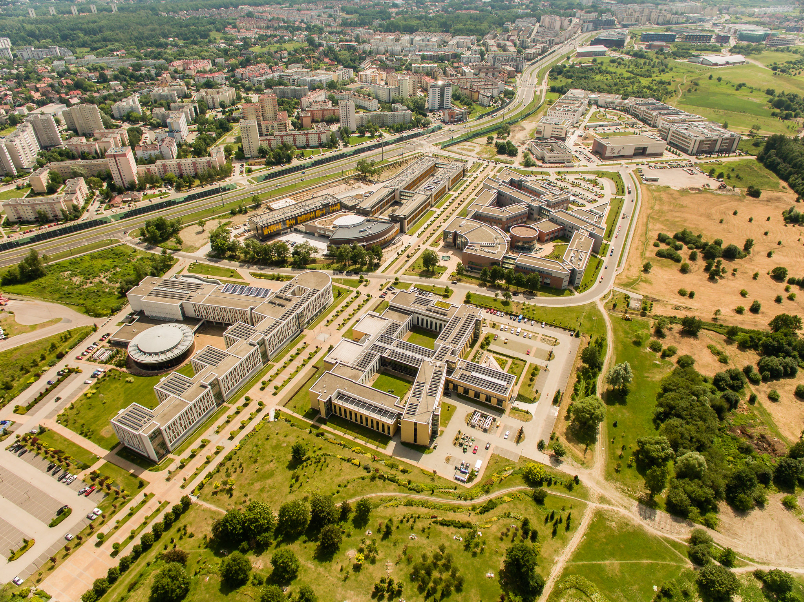
Today the University employs 3.8 thousand academic staff, including over 650 professors, as well as about 3.5 thousand other staff members, while providing education to about 40 thousand students.
Campus of the 600th Anniversary of the Jagiellonian University Revival,

Slide 5
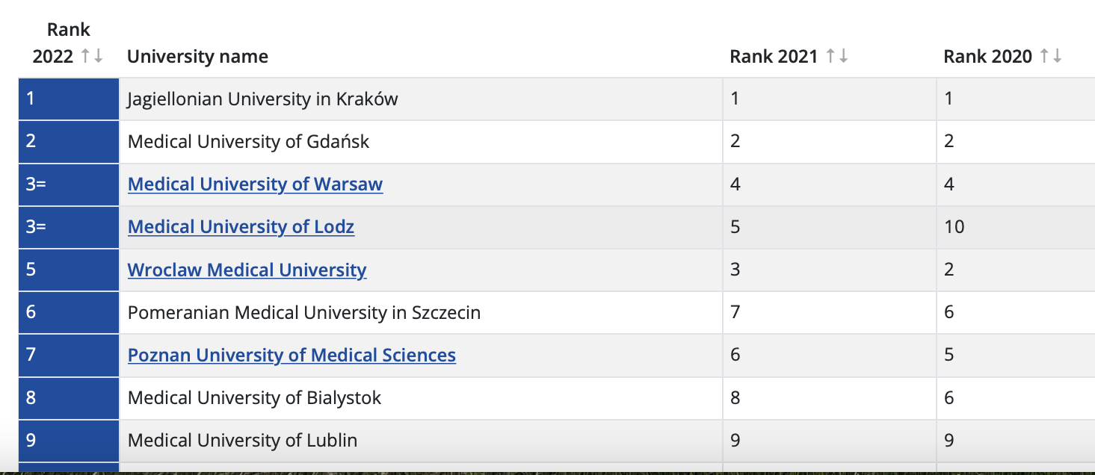

Slide 6
Students – born in XXI century
Teachers – born in XX century
Methods – born in XIX century

Slide 8
We propose the following necessary digital knowledge, skills, competencies to guide education and training materials for medical students and both junior and senior doctors to be equipped to deliver modern healthcare.
o Understand the technological concepts, e.g. concepts of e-Health, telehealth, machine and deep learning and robotics, and be able to use these technologies effectively in the daily practice of healthcare.
o Understand and be able to critically assess healthcare relevant types of data, data processing, the value of algorithms relevant to healthcare and of digitally assisted diagnostic, therapeutic and prognostic processes.
o Assess the (added) value, limitations and risks of new technologies, such as AI, Big Data and e-health applications, based on scientific research, for all stakeholders taking into account patient safety, patient value, patient trust, accountability and cost-effectiveness.
o Be able to work in a multidisciplinary team and actively contribute to innovation projects in digital healthcare.
o Reflect on the ethical, legal and social implications of those new technologies, and the technological development of healthcare.
o Be able to communicate with people working in the technology sector as well as being able to translate and communicate (digital) technologies with other healthcare workers and patients.
o Be able to effectively communicate with patients via electronic media, taking into account possible psychological, social and ethical implications of electronic communication.
o Identify new technologies and trends and understand how daily practice can be improved using technology and continuous innovation.

Slide 9
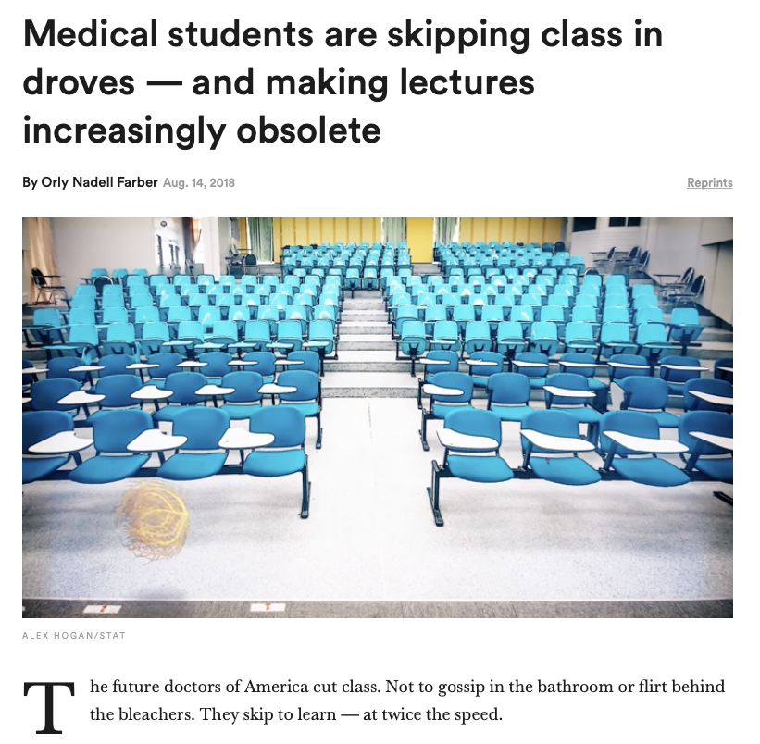

Slide 10
Rector
Dean
Management Team
Faculty members
Students

Slide 11
Medical education
Knowledge
Memorization
Factual recall
Pattern recognition
Problem solving
Critical thinking

Slide 12
Medical lectures
Traditional lecture
delivered live, in-person, and with no or minimal online component; typically limited student-lecturer interaction,
Design components: video, slide decks, and drawing on projector screen or blackboard
Interactivity: minimal (students ask questions, but do not influence lecture output or pace)
Can be delivered on-line, live

Slide 13
Medical lectures
Online lecture
intended for students to independently watch online, at their own pace; defined by low student interaction with the teaching modality (in some ways akin to a traditional lecture except viewed online)
Design components: audio, slide decks, drawings on blackboard, talking head
Interactivity: low to minimal (students can control speed of lecture, rewind, and fast-forward)

Slide 14
Medical lectures
Online module
intended for students to independently complete online, at their own pace; involves interactivity, in which students “click through” the module or complete “drag and drop” or other activities
Design components: “click-through” modules, embedded exercises (eg, matching, multiple choice questions); may also include components of online lectures
Interactivity: moderate to high (students actively engage with the online interface)

Slide 15
Flipped-classroom model
Students learn the content at home, and then apply it during in-class exercises
Clinical exposure
Practical skills

Slide 16
Creation of the course
Learning objectives
Select the course content (what remove?)
Course plan (how to divide into small lectures, seminars etc.)
Effective delivery methods
Production phase
Setting up online
Checking the acquisition of specific skills, knowledge etc. (learning objectives)

Slide 17
Module content
Learning objectives
Don’t underestimate the importance of learning outcomes
Because you know what your course will give your students, it does not mean that they will know.
If your students don’t know HOW your course is going to help them, they are unlikely to enroll in it.
Learning outcomes clearly explain, with measurable verbs, what the learner will be able to do, know and feel by the end of your course.
What skills will they be able to demonstrate?
What new knowledge will they have obtained?
What feelings will they have moved away from or to?

Slide 18
Selection of lecture/course content
Literature-driven development of content (eg, 6-step approach to curriculum development)
Faculty or expert selection of content
Medical student consultation

Slide 19
Lecture development
Developed from live lectures or recordings of live lectures
Consideration of multimedia design principles

Slide 21
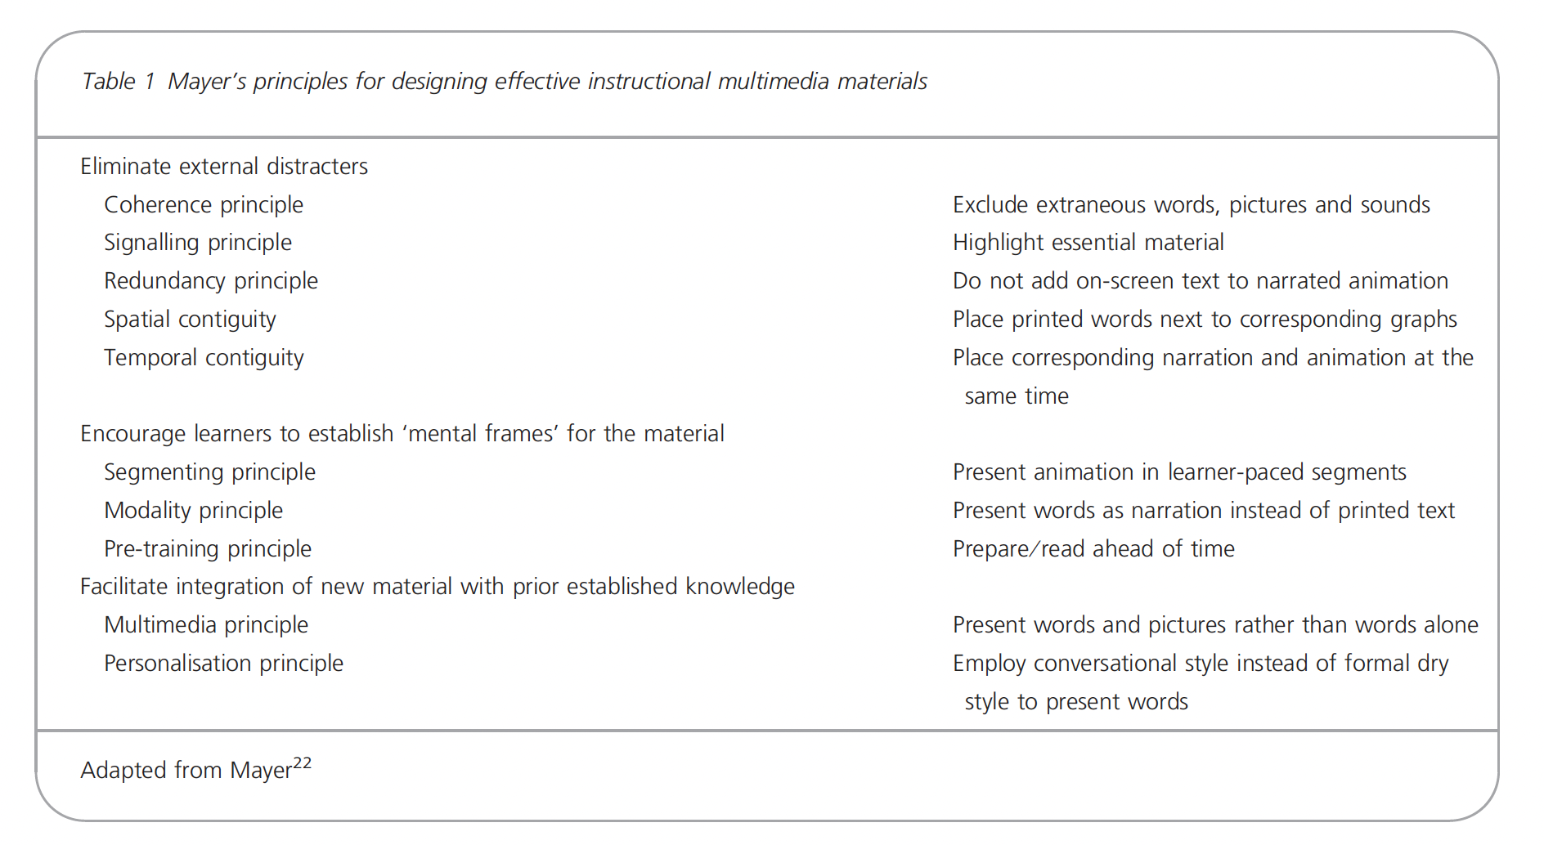

Slide 22
Treatment of hypovolemic shock
Crystaloids
0.9%NaCl
Ringer solution
5% glucose
Colloids
Albumin
Synthetic colloids
Blood and blood products

Slide 23
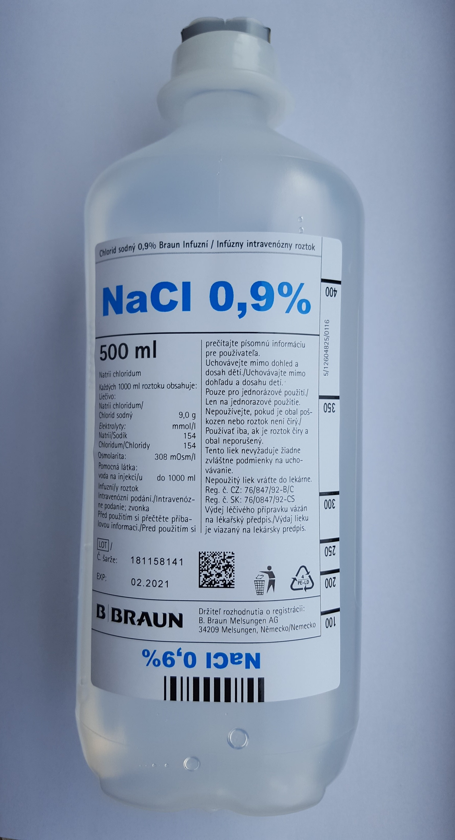
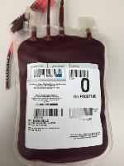
Treatment of hypovolemic shock
Blood and blood products
Crystaloids
Colloids

Slide 24
Jagiellonian University – our journey
Placing teaching materials for students in the cloud (presentations used in class)
Placing recorded lectures in the cloud
Preparation of the first on-line courses
Enabling academic teachers to choose the form of giving lectures (stationary or on-line)
2019 - decision to discontinue classroom lectures, to choose from live online lectures or uploading recorded lectures on the distance learning platform (Pegaz UJ).

Slide 25
Jagiellonian University – Medical College
On-line lectures
57 obligatory courses (6 years program)
364 hours on-line obligatory modules
>150 elective courses (12 should be selected)

Slide 26
Thank you for your attention
przemko.kwinta@uj.edu.pl

